Slide 1

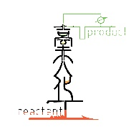
Python (I)
楊延齡
d00524018@ntu.edu.tw
09/04/2020

Slide 2






Advantage
1
Readability
Cross-platform
It's Free
Extensible

Slide 3


Package
2
Package | Feature
Numpy | Base N-dimensional array package
Pandas | Data structures and data analysis tools
SciPy | Fundamental library for scientific computing
Matplotlib | Comprehensive 2D Plotting
RDKit | Cheminformatics and machine-learning software
Biopython | A set of freely available tools for biological computation
SciKit-Learn | A set of modules for machine learning
Keras | A deep learning API written in Python

Slide 4
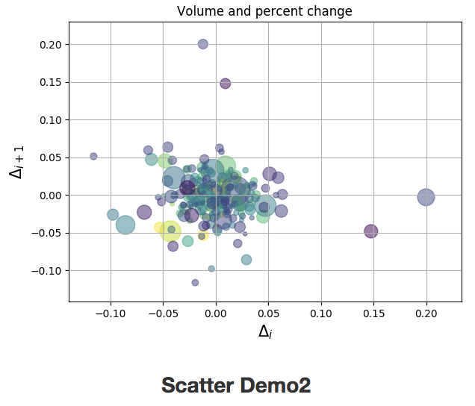
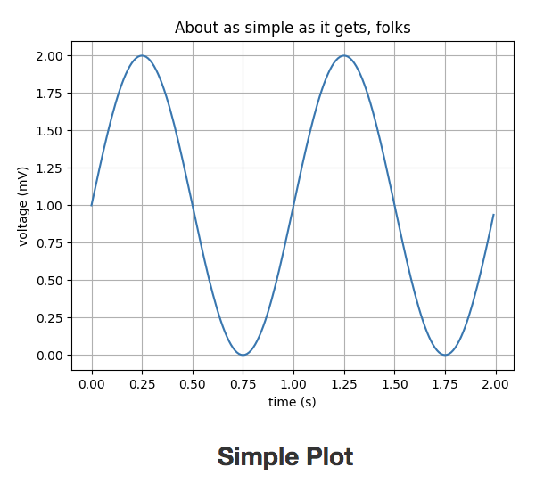
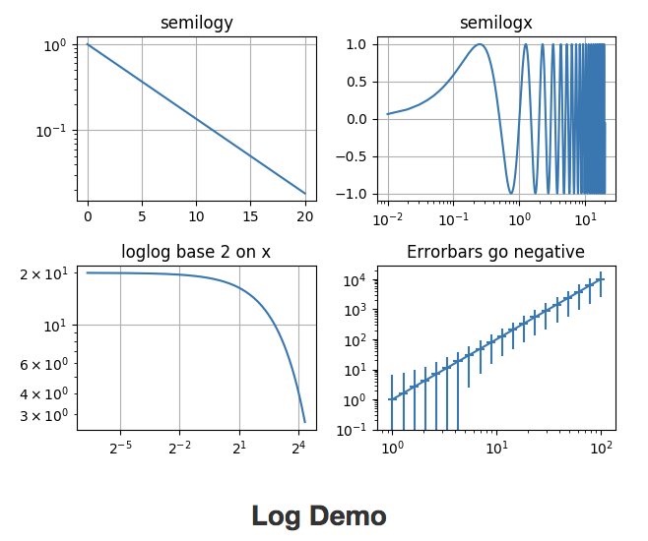
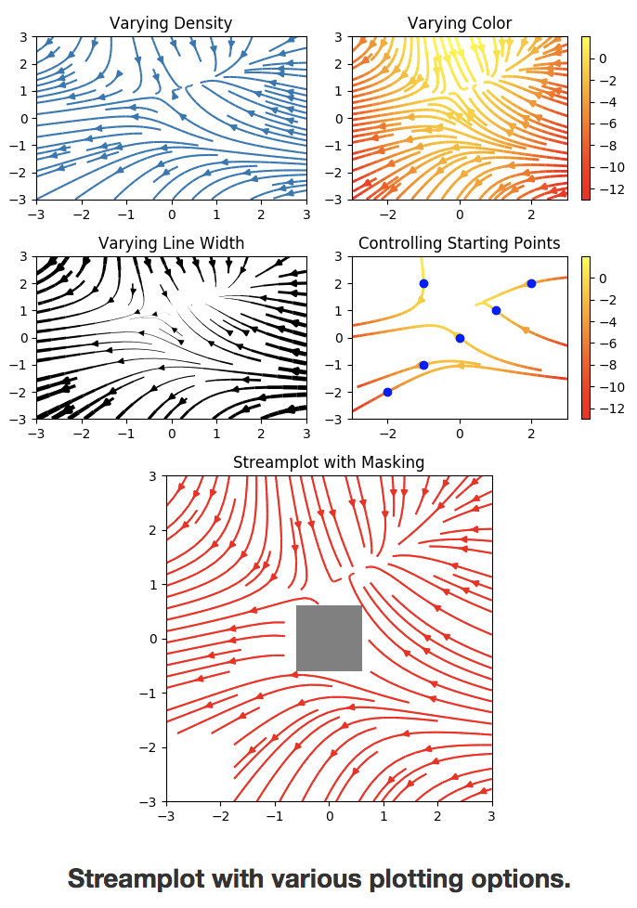
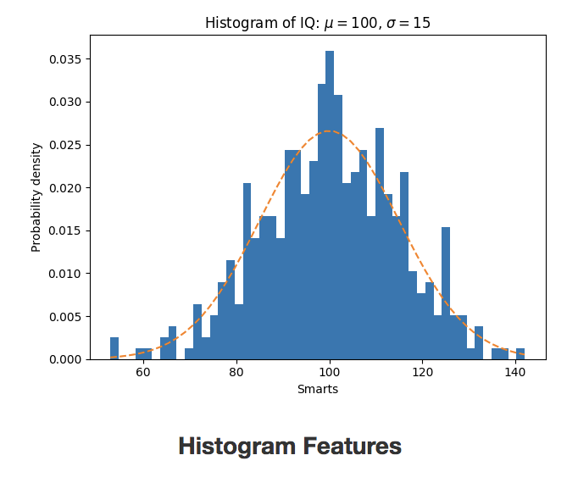
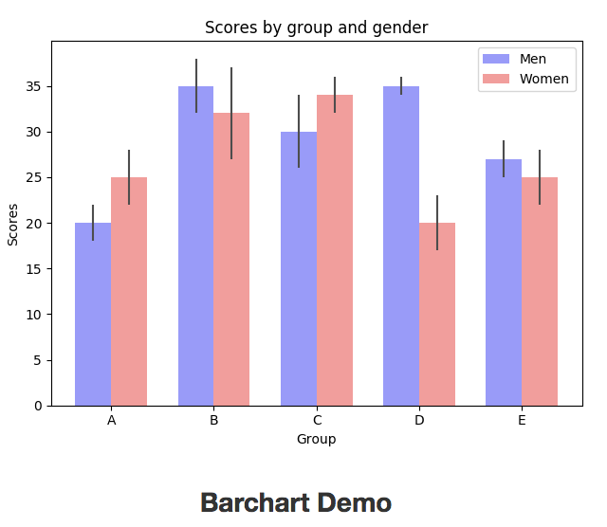
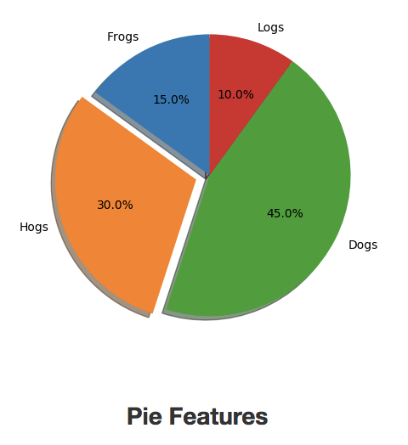
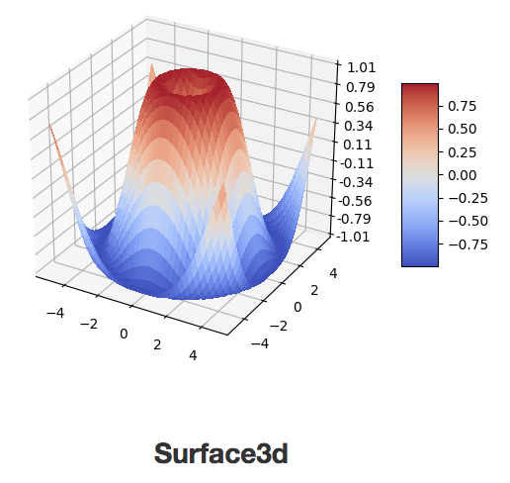
Matplotlib Package for Visualization in Python
3

Slide 5




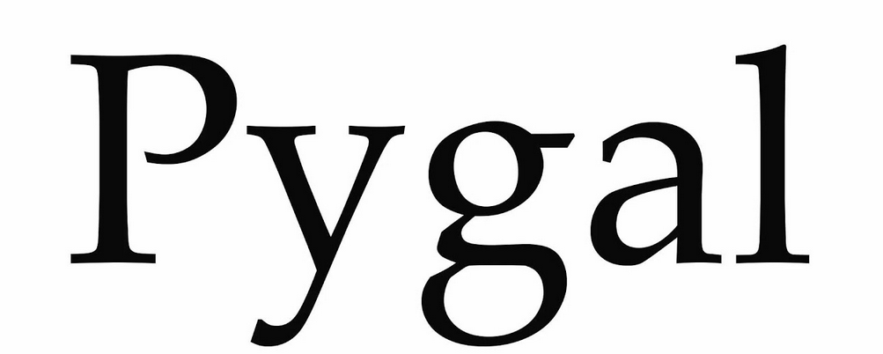
Top 5 Python Data Visualization Libraries
4

Slide 6




Other Package
5
Game Development
Pygame
Web Framework
Django
Graphical User Interface
GUI
Natural Language Processing
NLTK

Slide 7

Python Best IDEs in 2020
6
Jupyter
Google Colaboratory
Visual Studio Code
PyCharm
Spyder
Vim
Sublime Text 3
Thonny
Atom
PyDev

Slide 8
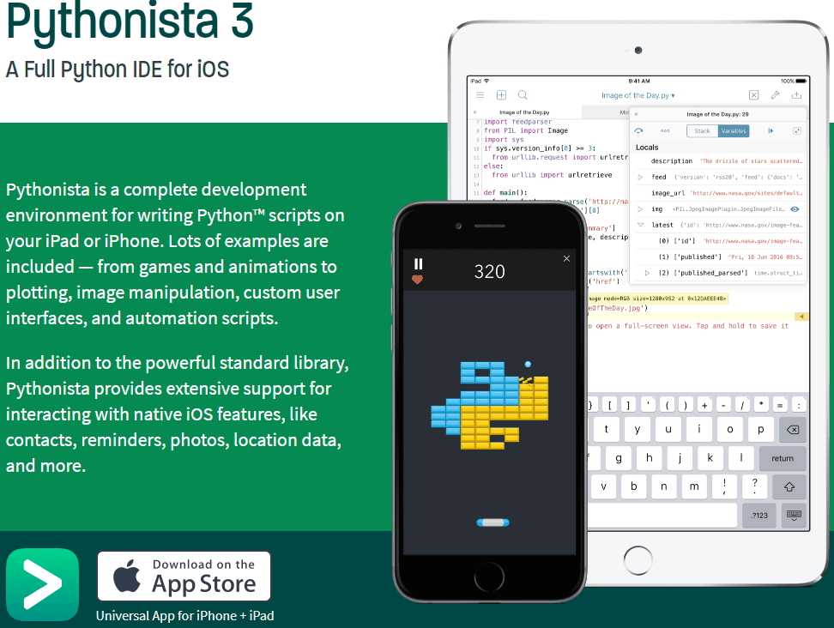

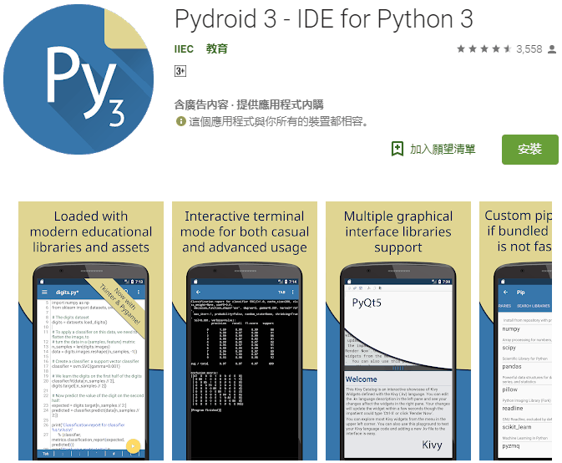
Python Smartphone App
7

Slide 9

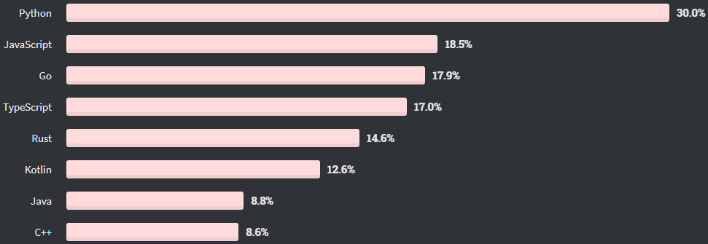
Most Wanted Programming Languages
8

Slide 10
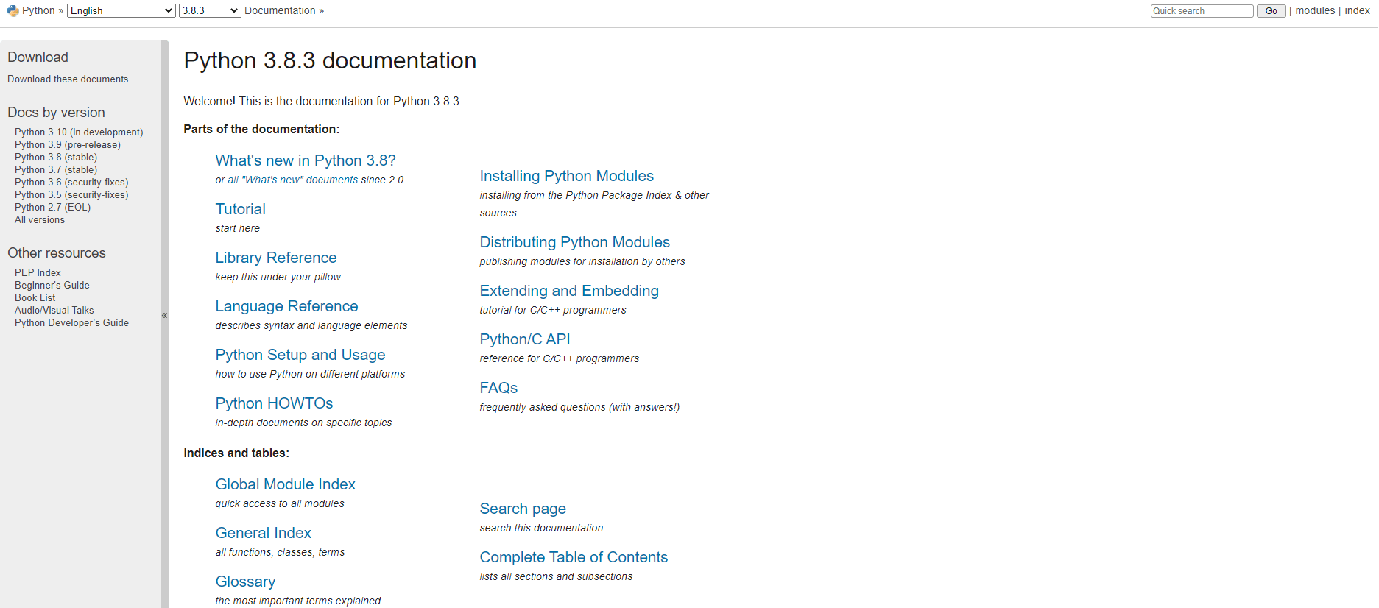
Python Document
9
Link

Slide 11

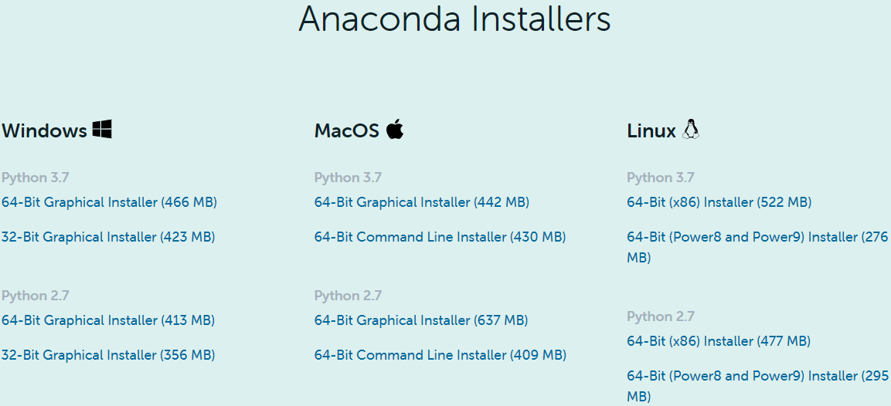

Installation
10
優點：處理有關資料分析與科學計算套件齊全
缺點：占空間
Step 3:
Step 1:
https://www.anaconda.com/download
Step 2:

Slide 12
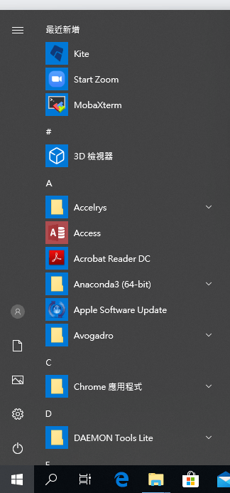
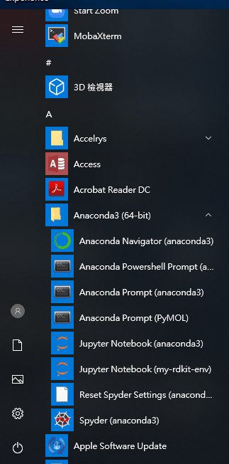
Anaconda Navigator (anaconda3)
11
Step 1.
Step 2.

Slide 13

JupyterLab
12

Slide 14
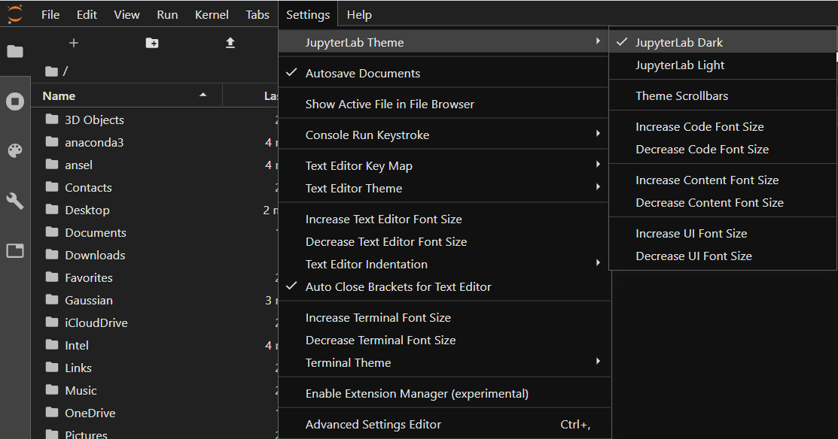
Theme
13

Slide 15
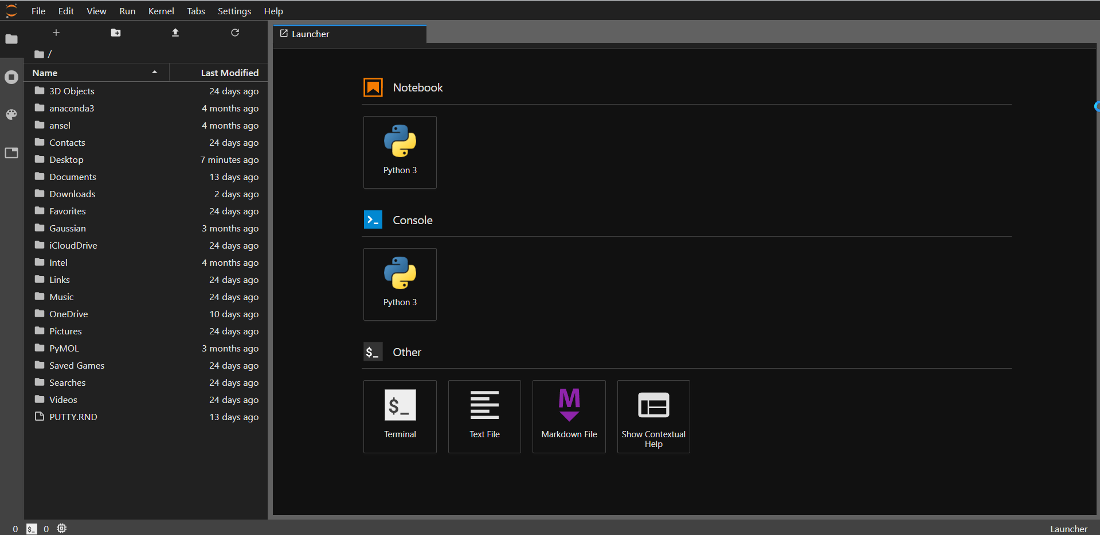
JupyterLab
14
Folder path
Create a Python project﻿
Folder

Slide 16
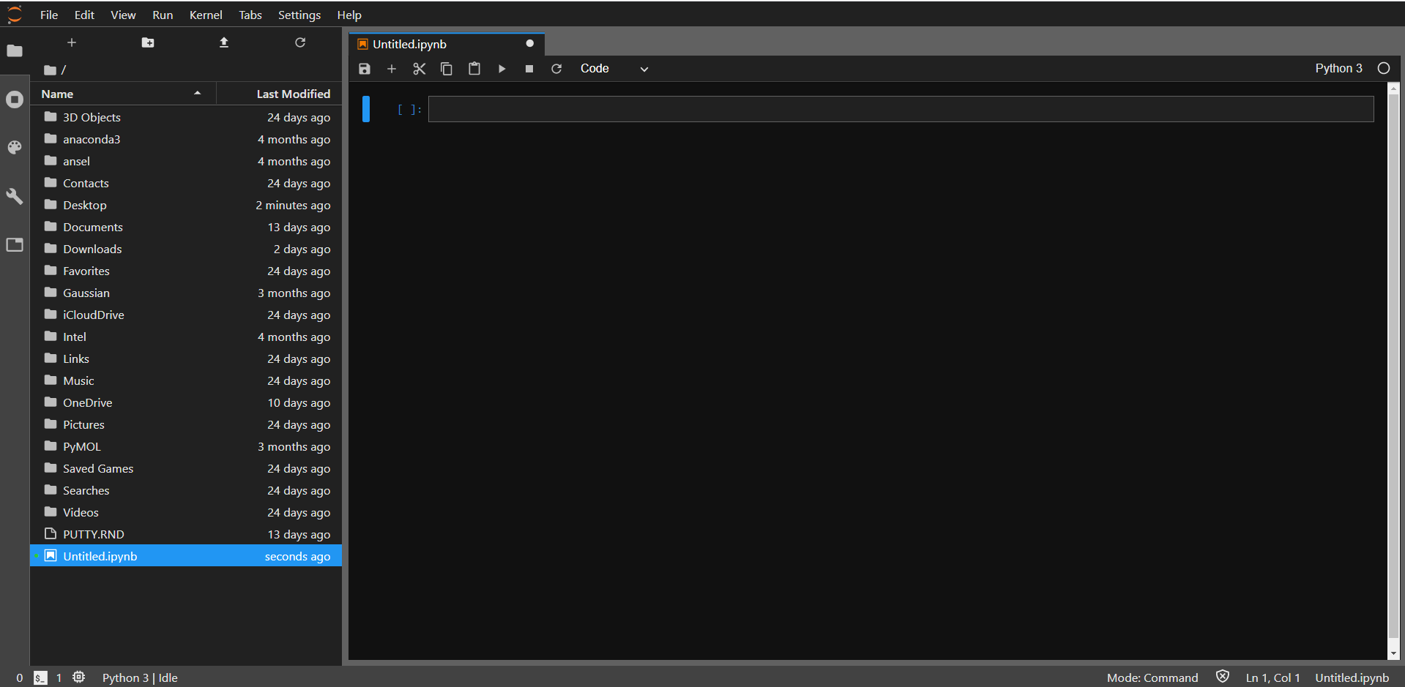
JupyterLab
15
File

Slide 17
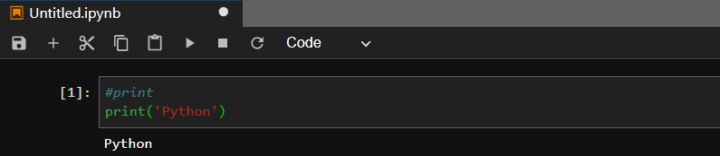
Compile
16
2
1
Code
3
Output Area
Code
Comment
>>> #print
Statement
>>> print('Python') # => Python

Slide 18
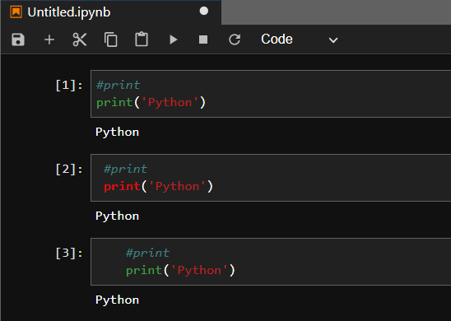
Fixing Python Indentation
17
Space
Tab
Statements should be left-aligned to the same indented level

Slide 19
JupyterLab
18
Command Mode
Ctrl+Enter | Run cell
Shift+Enter | Run cell, select below
Alt+Enter | Run cell, insert below
Ctrl+S | Save and Checkpoint
A/B | Insert cell above/below
DD | Delete selected cell
C | Copy selected cell
V | Paste cell below
Shift+V | Paste cell above
X | Cut selected cell
Z | Undo last cell deletion
Save
Insert a cell below
Cut the selected cell
Copy the selected cell
Paste cells
Run the selected cells
Interrupt the kernel
Restart the kernel

Slide 20
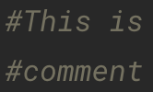
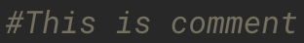
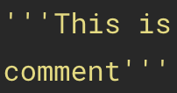
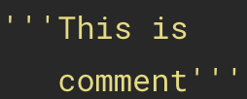
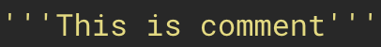
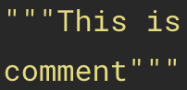
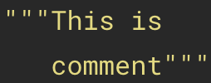

Python Comment
19
Single-line comments
Multi-line comment
Hash #
Hash #
Triple single quotes '''
Triple single quotes '''
Triple double quotes """
Triple double quotes """
''' & """ don’t be left-aligned to the same indented level

Slide 21
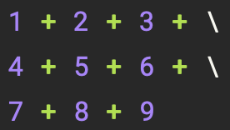
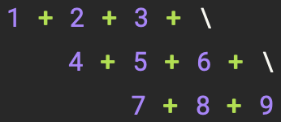
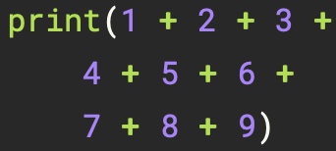
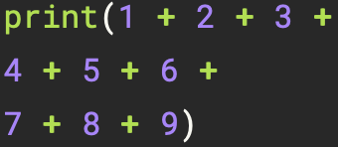
Python Statement
20
Single-line statement
Multi-line statement
Back slash \
Parentheses ( )
Semicolons ;
print (): prints the given object to the standard output device (screen)
Other
brackets [ ] and braces { }

Slide 22
Object
21
Python is an object oriented programming language
Almost everything in Python is an object, with its properties and methods

Slide 23
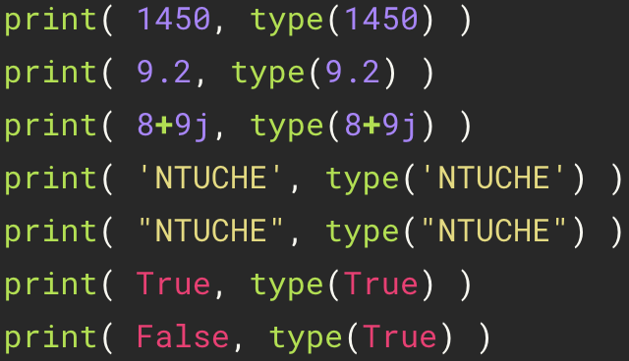
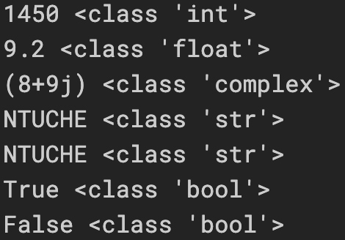
Basic Data Types
22
type (): returns type of the given object
Type | Meaning | Example
int | Integer | 1450
float | Floating point | 9.2
complex | Complex | 8+9j
str | String | "NTHUCHE" 'NTHUCHE'
bool | Boolean | True (1)、False (0)
Strings can be enclosed in single quotes ('...') or double quotes ("...")

Slide 24
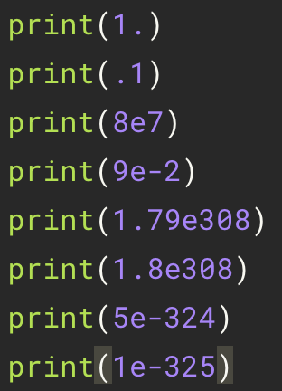
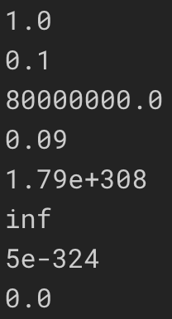
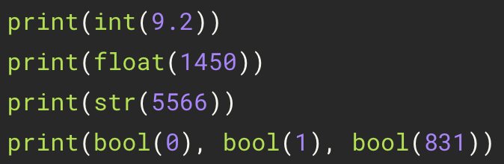
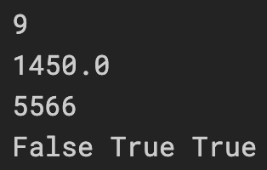
Basic Data Types
23
Floating-Point Numbers
Casting

Slide 25
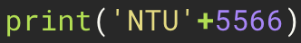
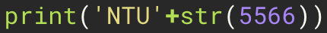
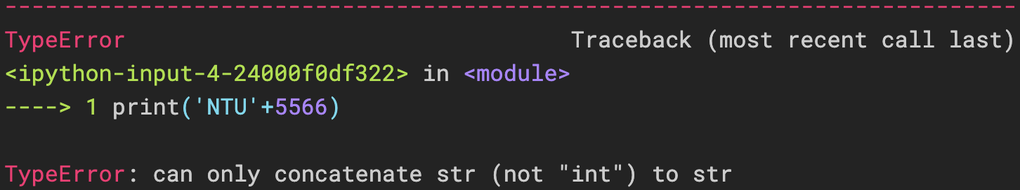
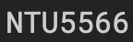
Basic Data Types
24
incorrect
correct

Slide 26
Python Operators
25
Arithmetic Operators | Meaning | Example
+ | Add two operands or unary plus | a + b +1
- | Subtract right operand from the left or unary minus | a – b -1
* | Multiply two operands | a * b
/ | Divide left operand by the right one (always results into float) | a / b
** | Exponent - left operand raised to the power of right | a ** b
// | Floor division - division that results into whole number adjusted to the left in the number line | a // b
% | Modulus - remainder of the division of left operand by the right | a % b

Slide 27
Python Operators
26
Assignment Operators | Example | Equivalent to
+= | a += b | a = a + b
-= | a -= b | a = a - b
*= | a *= b | a = a * b
/= | a /= b | a = a / b
**= | a **= b | a = a ** b
//= | a //= b | a = a // b
%= | a %= b | a = a % b

Slide 28
Python Operator Precedence
27
Assignment Operators | Example
( ) | parentheses
** | exponent
+x, -x | unary plus, unary minus
*, /, //, % | multiplication, division, floor division, modulo
+, - | addition, subtraction
>>> 1 + 2 * 3 # => 7
>>> 1 + 2 ** 4 * 2 # => 33
>>> 1 + 5 // 2 # => 3
>>> 1 + 5 % 2 # => 2
>>> (1 + 2) * 3 # => 9
>>> 1 + 2 ** (2 * 2) # => 17

Slide 29
Built-in Functions
28
Arithmetic Operators | Meaning | Example
print(*objects) | Print a message onto the screen | print(‘NTHU’)
type(object) | With one argument, return the type of an object. | type(114) # => int
int([x]) | Return an integer object constructed from a number or string x, or return 0 if no arguments are given | int(9.2) # => 9
float([x]) | Return a floating point number constructed from a number or string x | float(‘9.2’) # => 9.2
bool([x]) | Return a Boolean value | bool(0) # => False
abs(x) | Return the absolute value of a number. | abs(-43) # => 43
pow(base, exp) | Return base to the power exp | pow(2,4) # =>16

Slide 30
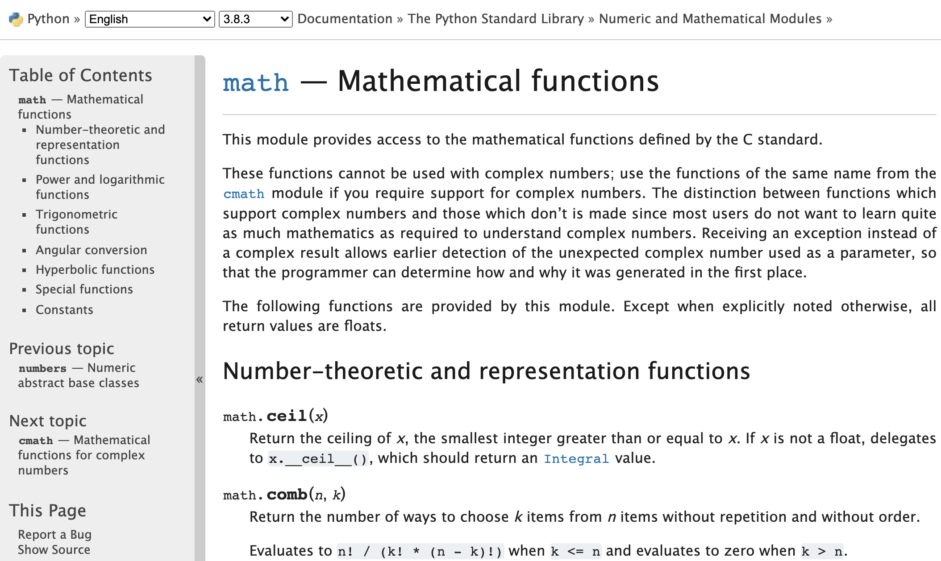
Mathematical functions
29
>>> import math
>>> print(math.exp(1))
>>> print(math.log(100,10))
>>> print(math.log(4,2))
>>> print(math.sqrt(4))
>>> print(math.pi)
>>> print(math.e)
https://docs.python.org/3/library/math.html

Slide 31
Practice
30
>>> 1 + 1 # => 2
>>> 8 - 1 # => 7
>>> 10 * 2 # => 20
>>> 35 / 5 # => 7.0
>>> 5 // 3 # => 1
>>> 5.0 // 3.0 # => 1.0 # works on floats too
>>> -5 // 3 # => -2
>>> -5.0 // 3.0 # => -2.0
>>> 10.0 / 3 # => 3.3333333333333335
>>> 7 % 3 # => 1
>>> 2**3 # => 8

Slide 32
Built-in Types
31
Variable
Sequence
index
CHE1 = '化熱'
CHE2 = '化動'
CHE3 = '單操'
CHE [0] = '化熱'
CHE = [ '化熱', '化動', '單操' ]
CHE [1] = '化動'
CHE [2] = '單操'
key
value
Mapping
CHE ['大二'] = '化熱'
CHE = {'大二':'化熱', '大三':'化動', '大四':'單操',…}
CHE ['大三'] = '化動'
CHE ['大四'] = '單操'

Slide 33
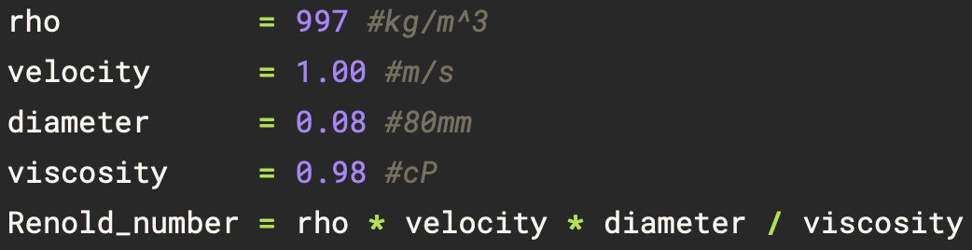
Variable and Assignment
32
Variable
(i) A-Z, a-z, 0-9, and underscore (_)
(ii) The first character of a variable name cannot be a digit
Assignment
(i) The equal sign (=) is used to assign a value to a variable

Slide 34
Built-in Types
33
Types | Name | Definition | Example
Numeric types | integer, float, complex |  | 1450, 9.2, 8+9j
Text Sequence Type | string | ' ' or " " | "NTUCHE" 'NTUCHE'
Sequence types | list | [ ] | [1,2,3]
 | tuple | ( ) | (1,2,3)
 | range | range() | range(3)
Mapping Types | dictionary | {key, value} | {'a':140, 'b':114}

Slide 35
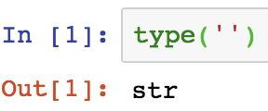
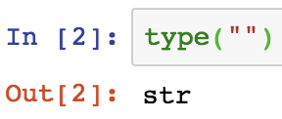
String
34
Index
Slice
a[start: stop(: step)]
>>> a[0:3] # characters from position 0 (included) to 3 (excluded) => 'NTU'
>>> a[3:6] # characters from position 3 (included) to 6 (excluded) => 'CHE'
>>> a = 'NTUCHE'
>>> a[:3] # character from the beginning to position 3 (excluded) => 'NTU'
>>> a[3:] # characters from position 3 (included) to the end => 'CHE'
>>> a[-3:] # characters from the third-last (included) to the end => 'CHE'
'N'
'T'
'U'
'C'
'H'
'E'
>>> a[0:6:2] # => 'NUH'
>>> a[::2] # => 'NUH'
>>> a[0:6:-2] # => ' '
>>> a[6:0:-2] # => 'ECT'
>>> a[::-2] # => 'ECT'
Index: 0 1 2 3 4 5
Index: -6 -5 -4 -3 -2 -1
len
Immutable
>>> a[0] # character in position 0 => 'N'
>>> a[5] # character in position 5 => 'E'
>>> a[-1] # last character => 'E'
>>> a[-2] # second-last character => 'H'
>>> a[-6] # => 'N'
>>> a[0] = 'C' # error
>>> a[2:] = 'NU' # error
>>> len(a) # => 6
>>> a[42] # error
>>> a[3:42] # => 'CHE'
>>> a[42:] # => ' '
Operators
>>> a[:] # => 'NTUCHE'
>>> a[:2] + a[2:] # => 'NTUCHE'
>>> a[:3] * 2 # => 'NTUNTU'

Slide 36
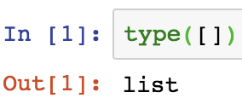
List [ ]
35
Index
Slice
a[start: stop(: step)]
>>> a[0:2] # => [1, 3]
>>> a[4:6] # => [9, 11]
>>> a[:2] # => [1, 3]
>>> a[4:] # => [9, 11]
>>> a[0:6:2] # => [1, 5, 9]
>>> a[::2] # => [1, 5, 9]
>>> a[6:0:-2] # => [11, 7, 3]
>>> a[0:6:-2] # => [ ]
>>> a[::-2] # => [11, 7, 3]
>>> a[:] # => [1, 3, 5, 7, 9, 11]
>>> a = [1, 3, 5, 7, 9, 11]
Note: All slice operations return a new list containing the requested elements.
1
3
5
7
9
11
Mutable
Index: 0 1 2 3 4 5
Index: -6 -5 -4 -3 -2 -1
>>> a[-1] = 13 # => [1, 3, 5, 7, 9, 13]
>>> a[0] # indexing returns the item 1
>>> a[-1] # => 11
len
Operators
>>> len(a) # => 6
>>> a = [1, 3]
>>> a += [5, 7] # => [1, 3, 5, 7]
>>> a *= 2 # => [1, 3, 5, 7, 1, 3, 5, 7]

Slide 37
Nested List
36
>>> nest = ['a', ['b', 'c'] , 'g']
'a'
['b', 'c']
'g'
# => nest[0] = 'a'
# => nest[1] = ['b', 'c']
# => nest[2] = 'g'
nest
Index 0 1 2
'b'
'c'
# => nest[1][0] = 'b'
# => nest[1][1] = 'c'
nest[1]
Index 0 1

Slide 38
Dynamic
37
list.append(obj)
list.insert(index, obj)
>>> x = [1, 2, 3]
>>> x.append('a')
>>> print(x) # => [1, 2, 3, 'a']
>>> x = [1, 2, 3]
>>> x.insert(2, 4)
>>> print(x) # => [1, 2, 4, 3]
Index 0 1 2 3
>>> x = [1, 2, 3]
>>> x.append([4, 5, 6])
>>> print(x) # => [ 1, 2, 3, [4, 5, 6] ]

Slide 39
Dynamic
38
list.pop( index = -1 )
del list[ index ]
>>> x = [1, 2, 3]
>>> y = x.pop()
>>> print(x) # => [1, 2]
>>> print(y) # => 3
>>> x = [1, 2, 3]
>>> del x[1]
>>> print(x) # => [1, 3]
>>> x = [1, 2, 3]
>>> del x[1:3]
>>> print(x) # => [1]
>>> x = [1, 2, 3]
>>> y = x.pop(1)
>>> print(x) # => [1, 3]
>>> print(y) # => 2
>>> x = [1, 2, 3]
>>> del x[:]
>>> print(x) # => []

Slide 40
Practice
39
>>> L = ['a', 'b', ['cc', 'dd', ['eee', 'fff']], 'g', 'h']
>>> print(L[2]) # => ['cc', 'dd', ['eee', 'fff']]
>>> print(L[2][2]) # => ['eee', 'fff']
>>> print(L[2][2][0]) # => eee
>>> L = ['a', ['bb', 'cc'], 'd']
>>> L[1].append('xx')
>>> print(L) # => ['a', ['bb', 'cc', 'xx'], 'd']
>>> L[1].insert(0, 'yy')
>>> print(L) # => ['a', ['yy', 'bb', 'cc', 'xx'], 'd']
>>> x = L[1].pop(1)
>>> print(L) # => ['a', ['yy', 'cc', 'xx'], 'd']

Slide 41
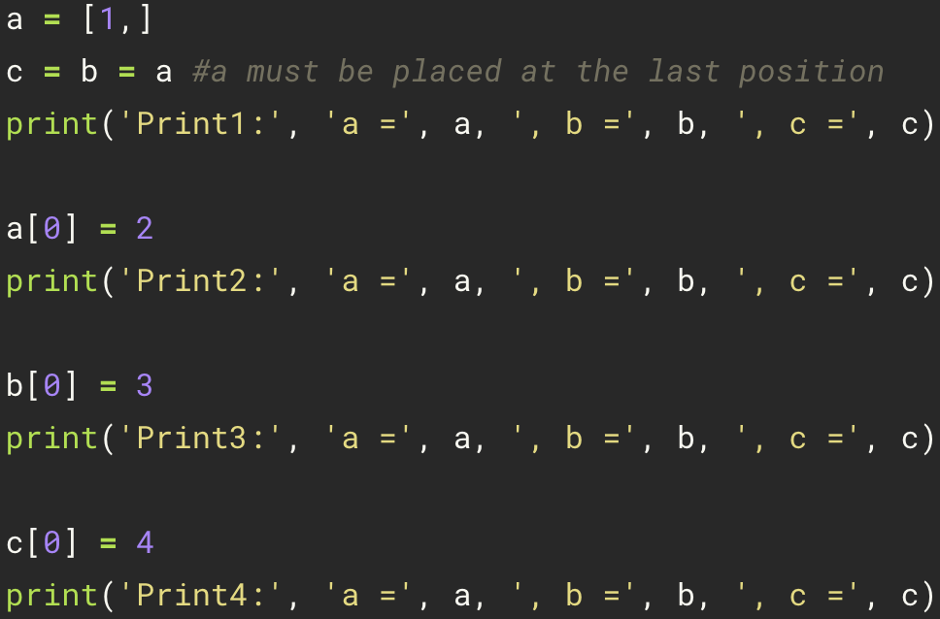
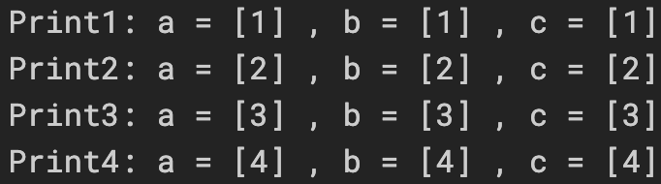
Mutability
40
Aliasing: if one variable is assigned to another, all variables refer to the same object

Slide 42
Mutability
41
a
a
a
[1, ]
[2, ]
[3, ]
b
b
b
c
c
c

Slide 43


Dynamic
42
+=: Augmented assignment
For list, append() and “+=” are an in-place operation

Slide 44
Dynamic
43
a
a
a
[1, 2, 3, ]
[1, ]
[1, 2, ]
b
b
b
c
c
c

Slide 45


= vs. +=
44
If a variable is modified, it can't be mutated (creating a new object).

Slide 46


= vs. +=
45
a
a
[1, ]
[1, 2, ]
a
[1, 2, ]
b
b
b
c
c
[1, 2, 3, ]
copy
c

Slide 47


= vs. +=
46

Slide 48
List Copy
47
Aliasing
Cloning (copy)
b = list(a)
b = a[:]
b = a.copy()
b = a
[1, ]
a
a
[1, ]
b
[1, ]
b
copy

Slide 49

List Copy
48
only a is changed

Slide 50
List Copy
49
Shallow Copy
Deep Copy
b = list(a)
b = a[:]
b = a.copy()
import copy
a = [1, [2,3]]
b = copy.deepcopy(a)
nested list

Slide 51


Shallow Copy vs. Deep Copy
50
Shallow Copy
Deep Copy
>>> a = [ 1, [2, 3] ]
>>> b = a.copy()
>>> print('a =', a, ', b =',b)
>>> b[0] = 5
>>> b[1][1] = 6
>>> print('a =', a, ', b =',b)
>>> import copy
>>> a = [ 1, [2, 3] ]
>>> b = copy.deepcopy(a)
>>> b[0] = 5
>>> b[1][1] = 6
>>> print('a =', a, ', b =',b)
change

Slide 52
Practice
51
>>> x = [1, 2, 3]
>>> x[0] = -4
>>> print(x) # => [-4, 2, 3]
>>> y = x
>>> x[0] = x[0] + 4
>>> print(y) # => [0, 2, 3]
>>> x += [4]
>>> print(y) # => [0, 2, 3, 4]
>>> x = x + [4]
>>> print(x) # => [0, 2, 3, 4, 4]
>>> print(y) # => [0, 2, 3, 4]
>>> import copy
>>> a = [[1, 1], [2, 2]]
>>> b = a.copy()
>>> c = copy.deepcopy(a)
>>> a[0][1] = 3
>>> print(a) # => [[1, 3], [2, 2]]
>>> print(b) # => [[1, 3], [2, 2]]
>>> print(c) # => [[1, 1], [2, 2]]

Slide 53







Tuple ( )
52
Index
Slice
Operators
the same as list
Packing and Unpacking
>>> a = (1, 3, 5, 7, 9, 11) or >>> a = 1, 3, 5, 7, 9, 11
1
3
5
7
9
11
>>> a = (1, 2, 3)
Tuple packing
Index: 0 1 2 3 4 5
Index: -6 -5 -4 -3 -2 -1
>>> a[0] # indexing returns the item 1
>>> a[-1] # => 11
Immutable
match
Tuple Unpacking
>>> a[-1] = 13 # error
execute swap conveniently!!

Slide 54




Mutability vs Immutability
53
List
Tuple
b sees the change
“+=“ is an in-place operation
Dynamic a
a returns a new object
“+=“ is also an non-in-place operation
Copy new a

Slide 55




Reassigning Tuples
54
Tuple is immutable object

Slide 56

Range ( )
55
Index
Immutable
range(stop)
range(start, stop[, step])
>>> a[-1] = 13 # error
>>> a = range(6)
>>> a = range(0, 12, 2)
0
1
2
3
4
5
0
2
4
6
8
10
Index: 0 1 2 3 4 5
Index: -6 -5 -4 -3 -2 -1
0 1 2 3 4 5
-6 -5 -4 -3 -2 -1
range() does not produce a list of integers, but instead generates integers one by one as needed. This saves computer memory and can speed up programs.
>>> a[2] # => 2
>>> a[-1] # => 5
>>> a[2] # => 4
>>> a[-1] # => 10
Slice
Operators
the same as list

Slide 57
Built-in Types
56
Type | Mutable | Immutable | Example
integer, float, complex |  | ✓ | 1450, 9.2, 8+9j
string |  | ✓ | "NTHUCHE" 'NTHUCHE'
list | ✓ |  | [1,2,3]
tuple |  | ✓ | (1,2,3)
range |  | ✓ | range(3)
dictionary | ✓ |  | {'a':140, 'b':114}

Slide 58

Dict { }
57
Key
A dictionary key must be of a type
that is immutable!!!
Addition
>>> a = {}
>>> a['a'] = 1 # => {'a': 1}
>>> a['b'] = 2 # => {'a': 1, 'b': 2}
>>> d = {'int': 1, 'float': 2.2, 'bool': True}
>>> d['float'] # => 2.2
>>> a = {'a': 1, 'b': 3, 'c': 5, 'd': 7}
>>> a['a'] # => 1
>>> a['c'] # => 5
>>> d = {(1, 1): 'a', (1, 2): 'b', (2, 1): 'c'}
>>> d[(1,1)] # => 'a'
>>> d[(2,1)] # => 'c'
key:
'a'
'b'
'c'
'd'
>>> a = {0: 'a', 1: 'b’, 2.2: 'c'}
>>> a[0] # => 'a'
>>> a[2.2] # => 'c'
value:
1
3
5
7
len
Deletion
Mutable
>>> a = {'a': 1, 'b': 3, 'c': 5, 'd': 7}
>>> len(a) # => 4
>>> a = {}
>>> a['a'] = 1 # => {'a': 1}
>>> a['b'] = 2 # => {'a': 1, 'b': 2}
>>> del a['a'] # => {'b': 2}
>>> a['d'] = 9 # => {'a': 1, 'b': 3, 'c': 5, 'd': 9}

Slide 59
Keys and Values
58
>>> dict = {'a':1,'b':2}
Keys
Values
>>> keys = dict.keys()
>>> print(keys) # => dict_keys(['a', 'b'])
>>> values = dict.values()
>>> print(values) # => [1, 2]
<class 'dict_keys'>
<class 'list'>
returns a list of all the keys in the dictionary
Key and Values
>>> keys_values = dict.items()
>>> print(keys_values) # => dict_items([('a', 1), ('b', 2)])
<class 'dict_items'>
return a list of a given dictionary’s (key, value) tuple pair

Slide 60
Nest Dict { }
59
>>> family = {'grandpa': 'Jay', 'parent':['Peter', 'Lynn'], 'children':{'bro': 'Ping', 'sis': 'Xi'}}
key:
'grandpa'
'parent'
'children'
value:
'Jay'
['Peter', 'Lynn']
{'bro': 'Ping', 'sis': 'Xi'}
family['parent']
'Peter'
'Lynn'
'Ping'
'Xi'
family['children']
index: 0
1
key: 'bro'
'sis'
>>> family['grandpa'] #=> 'Jay'
>>> family['children'] #=> {'bro': 'Ping', 'sis': 'Xi'}
>>> family['parent'] #=> ['Peter', 'Lynn']
>>> family['children']['bro'] #=> 'Ping'
>>> family['parent’][0] #=> 'Peter'

Slide 61
Dynamic
60
update
clear
>>> a = {'a':1}
>>> b = {'b':2, 'c':3}
>>> a.update(b)
>>> print(a) # => {'a': 1, 'b': 2, 'c': 3}
>>> a = {'zero':0, 'one':1}
>>> a.clear()
>>> print(a) # => {}

Slide 62
Practice
61
>>> x, y = 1, 2 >>> print(x) print(x) # => 1 >>> print(y) print(y) # => 2 >>> t = (10, 20) >>> x, y = t >>> print(x) # => 10 >>> print(y) # => 20 >>> x, y = y, x >>> print(x) # => 20 >>> print(y) # => 10
>>> a = {}
>>> a = {'zero':0}
>>> a['one'] = 1
>>> print(a) # => {'zero': 0, 'one': 1}
>>> a['zero'] = 2
>>> print(a) # => {'zero': 2, 'one': 1}
>>> a = {'x':{'x0':0,'x1':1}, 'y':{'y0':0,'y1':1}}
>>> a['x']['x0'] = 2
>>> a['y']['y1'] = 3
>>> print(a)

Slide 63
Built-in Types
62
Immutable object (str, int, tuple, etc.): All the variables that refer to it will always see the same value, but operations that transform that value into a new value always return a new object.
Mutable object (list, dict, set, etc.): We can use some specific operations to mutate it and all the variables that refer to it will see the change.
Type | Mutable | Immutable
integer, float, complex |  | ✓
string |  | ✓
list | ✓
tuple |  | ✓
range |  | ✓
dictionary | ✓

Slide 64




Numpy
63
Sequence
Array

Slide 65
Numpy Array vs. Python List
64
Numpy arrays consume less memory than Python list
Numpy arrays are fast as compared to the Python list
Numpy arrays are great for numerical operations; Python list cannot directly handle math operations

Slide 66



Array Creation
65
empty function
import numpy
zeros function
random and float
ones function
full function
float
arange function
integer
array function

Slide 67


Numpy Method
66
ndim
shape
size
dtype

Slide 68


Same Data Type
67
All elements are same data type
>>> a = np.empty(3)
>>> print(a)
>>> a[0] = int(1)
>>> print(a)
>>> a = np.array([1, 2., 'NTU'])
>>> print(a)

Slide 69


dtype
68
random and integer
integer
float

Slide 70



N-dimension Array
69
Column
index
0 1 2 . . . n
0
1
2
.
m
$$\left[\begin{matrix}0 & 1 & 2 & . & . \\ 3 & 4 & 5 & . & . \\ 6 & 7 & 8 & . & . \\ . & . & . & . & . \\ . & . & . & . & .\end{matrix}\right]$$
$$\left[\begin{matrix}0 \\ 1 \\ 2 \\ . \\ .\end{matrix}\right]$$
$$\left[\begin{matrix}a \\ b \\ \begin{aligned}c \\ . \\ .\end{aligned}\end{matrix}\right]$$
=
Row
a[1][1]=4
a[1,1]=4
m×n matrix
a[1]= 3 4 5 . .

Slide 71


Creating an n-dimension Array
70

Slide 72


reshape
71
>>> a = np.arange(6).reshape(2,3)
0 | 1 | 2
3 | 4 | 5
2×3 matrix
# => $\left[\begin{matrix}0 & 1 & 2 \\ 3 & 4 & 5\end{matrix}\right]$
>>> a = np.arange(6)
0 | 1 | 2 | 3 | 4 | 5
>>> a = np.arange(6).reshape(3,2)
# => [0 1 2 3 4 5]
0 | 1
2 | 3
4 | 5
>>> print(a.shape)
3×2 matrix
# => (6, )
$$\text{\# =>}\left[\begin{matrix}0 & 1 \\ 2 & 3 \\ 4 & 5\end{matrix}\right]$$
(1-Dimension)

Slide 73
(6, ), (1, 6), (6, 1)
72
>>> a = np.arange(6)
# => [0 1 2 3 4 5]
>>> print(a.shape)
# => (6, )
(1-Dimension)
>>> a = np.arange(6).reshape(1,6)
# => [[0 1 2 3 4 5]]
>>> print(a.shape)
# => (1, 6)
(2-Dimension)
>>> a = np.arange(6).reshape(6,1)
# => [[0] [1] [2] [3] [4] [5]]
>>> print(a.shape)
# => (6, 1)
(2-Dimension)

Slide 74

Get Value
73
>>> a = np.arange(9).reshape(3,3)
>>> print(a)
$$\text{a}=\left[\begin{matrix}0 & 1 & 2 \\ 3 & 4 & 5 \\ 6 & 7 & 8\end{matrix}\right]$$
# => a = [ [0 1 2] [3 4 5] [6 7 8] ]
(2-Dimension)
>>> print(a[1:])
>>> print(a[1:][1])
# => [ [3 4 5] [6 7 8] ]
# => [6 7 8]
(1-Dimension)
(2-Dimension)
>>> print(a[1:,1])
# => [4 7]
(1-Dimension)

Slide 75




Index and Slice
74
column
Index
Slice
0 1 2
0
1
2
$$\left[\begin{matrix}0 & 0 & 0 \\ 0 & 1 & 0 \\ 0 & 0 & 2\end{matrix}\right]$$
row
>>> a = np.arange(25).reshape(5,5)
>>> a[0, 2:4] # => [2 3]
>>> a = np.array([[0, 0, 0], [0, 1, 0], [0, 0, 2]])
>>> a[3:, 3:] # => [[18 19] [23 24]]
>>> print(a[1, 1]) # => 1
>>> a[:, 1] # => [ 1 6 11 16 21]
>>> a[2, 1] = 10
>>> print(a)
# => [[ 0 0 0] [ 0 1 0] [ 0 10 2]]
>>> a[2::2, ::2] # => [[10 12 14] [20 22 24]]
$$\left[\begin{matrix}0 & 0 & 0 \\ 0 & 1 & 0 \\ 0 & 10 & 2\end{matrix}\right]$$
0 1 2 3 4
column
0
1
2
3
4
$$\left[\begin{matrix}\begin{matrix}0 & 1 & 2 \\ 5 & 6 & 7 \\ 10 & 11 & 12\end{matrix} & \begin{matrix}3 & 4 \\ 8 & 9 \\ 13 & 14\end{matrix} \\ \begin{matrix}15 & 16 & 17 \\ 20 & 21 & 22\end{matrix} & \begin{matrix}18 & 19 \\ 23 & 24\end{matrix}\end{matrix}\right]$$
$$\left[\begin{matrix}0 & 0 & 0 \\ 0 & 1 & 0 \\ 0 & 10 & 2\end{matrix}\right]$$
row
>>> a[1] # => [0 1 0]

Slide 76

Operation
75
Sum
Statistics
>>> x = np.array([ [1, 2, 3, 4] ])
>>> x = np.array([1, 2, 3, 1])
>>> print( x.mean() ) # => 1.75
>>> print( np.median(x) ) # => 1.5
>>> print( x.std() ) # => 0.82915619758885
>>> np.sum(x) # => 10
>>> x = np.array([ [1, 1], [2, 2] ])
2
4
$$\left[\begin{matrix}1 & 1 \\ 2 & 2\end{matrix}\right]$$
3 3
Extrema
>>> x.sum(axis=0) # columns (first dimension) => [3 3]
>>> print( x[:, 0].sum(), x[:, 1].sum() ) # => 3 3
>>> x = np.array([1, 3, 2])
>>> print( x.min() ) # => 1
>>> print( x.max() ) # => 3
>>> x.sum(axis=1) # rows (second dimension) => [2 4]
>>> print( x[0, :].sum(), x[1, :].sum() ) # => 2 4

Slide 77




Transpose and Inverse
76
Transpose
Inverse
A = $\left[\begin{matrix}1 & 2 & 3 \\ 4 & 5 & 6 \\ 7 & 8 & 9\end{matrix}\right]$,
A^{T} = $\left[\begin{matrix}1 & 4 & 7 \\ 2 & 5 & 8 \\ 3 & 6 & 9\end{matrix}\right]$
A = $\left[\begin{matrix}a & b \\ c & d\end{matrix}\right]$,
A⁻¹ = $\frac{1}{ad−bc}\left[\begin{matrix}d & −b \\ −c & a\end{matrix}\right]$
>>> A = np.array([ [1,2,3], [4,5,6], [7,8,9] ])
>>> AT = A.T
>>> print(AT)
>>> A = np.array([ [1,2], [3,4] ])
>>> Ainv = np.linalg.inv(A)
>>> print(Ainv)
# => [ [1 4 7] [2 5 8] [3 6 9] ]
# => [ [-2. 1. ] [ 1.5 -0.5] ]

Slide 78




Matrix-Scalar Operations
77
$$\left[\begin{matrix}0 & 1 & 2 \\ 3 & 4 & 5 \\ 6 & 7 & 8\end{matrix}\right]$$
>>> a = np.arange(9).reshape(3,3) # => [ [0 1 2] [3 4 5] [6 7 8] ]
$$\left[\begin{matrix}1 & 2 & 3 \\ 4 & 5 & 6 \\ 7 & 8 & 9\end{matrix}\right]$$
>>> b = a + 1 # => [ [1 2 3] [4 5 6] [7 8 9] ]
$$\left[\begin{matrix}0 & 2 & 4 \\ 6 & 8 & 10 \\ 12 & 14 & 16\end{matrix}\right]$$
>>> c = a * 2 # => [ [ 0 2 4] [ 6 8 10] [12 14 16] ]
$$\left[\begin{matrix}0 & 1 & 4 \\ 9 & 16 & 25 \\ 36 & 49 & 64\end{matrix}\right]$$
>>> d = a ** 2 # => [ [ 0 1 4] [ 9 16 25] [36 49 64] ]

Slide 79



Matrix-Matrix Operations
78
>>> a = np.arange(9).reshape(3,3) # => [ [0 1 2] [3 4 5] [6 7 8] ]
>>> b = np.ones(9).reshape(3,3)+1 # => [ [2. 2. 2.] [2. 2. 2.] [2. 2. 2.] ]
>>> a - b # => [ [-2. -1. 0.] [ 1. 2. 3.] [ 4. 5. 6.] ]
$\left[\begin{matrix}0 & 1 & 2 \\ 3 & 4 & 5 \\ 6 & 7 & 8\end{matrix}\right]−\left[\begin{matrix}2. & 2. & 2. \\ 2. & 2. & 2. \\ 2. & 2. & 2.\end{matrix}\right]=$ $\left[\begin{matrix}−2. & −1. & 0. \\ 1. & 2. & 3. \\ 4. & 5. & 6.\end{matrix}\right]$
Elementwise product
>>> a * b # => [ [ 0. 2. 4.] [ 6. 8. 10.] [12. 14. 16.] ]
$\left[\begin{matrix}0 & 1 & 2 \\ 3 & 4 & 5 \\ 6 & 7 & 8\end{matrix}\right]°\left[\begin{matrix}2. & 2. & 2. \\ 2. & 2. & 2. \\ 2. & 2. & 2.\end{matrix}\right]=$ $\left[\begin{matrix}0. & 2. & 4. \\ 6. & 8. & 10. \\ 12. & 14. & 16.\end{matrix}\right]$
Matrix product
>>> a @ b # => [ [ 6. 6. 6.] [24. 24. 24.] [42. 42. 42.] ]
(a.dot(b))
$\left[\begin{matrix}0 & 1 & 2 \\ 3 & 4 & 5 \\ 6 & 7 & 8\end{matrix}\right]\left[\begin{matrix}2. & 2. & 2. \\ 2. & 2. & 2. \\ 2. & 2. & 2.\end{matrix}\right]=$ $\left[\begin{matrix}6. & 6. & 6. \\ 24. & 24. & 24. \\ 42. & 42. & 42.\end{matrix}\right]$

Slide 80






Example
79
$$\left\{\begin{aligned}2x+3y=21 \\ 4x+2y=22\end{aligned}\right.$$
AX = B
A⁻¹AX = A⁻¹B
X = A⁻¹B
A = $\left[\begin{matrix}2 & 3 \\ 4 & 2\end{matrix}\right]$,
X = $\left[\begin{matrix}x \\ y\end{matrix}\right]$,
B = $\left[\begin{matrix}21 \\ 22\end{matrix}\right]$
A = $\left[\begin{matrix}a & b \\ c & d\end{matrix}\right]$,
A⁻¹ = $\frac{1}{ad−bc}\left[\begin{matrix}d & −b \\ −c & a\end{matrix}\right]$
>>> import numpy as np
>>> A = np.array([ [2,3], [4,2] ])
>>> B = np.array([21,22]).reshape(2,1)
>>> a = A[0,0]
>>> b = A[0,1]
>>> c = A[1,0]
>>> d = A[1,1]
>>> invA = [ [d,-b], [-c,d] ] / (a*d-b*c)
>>> X = invA @ B
>>> print(X) # => [ [3.] [5.] ]
>>> import numpy as np
>>> A = np.array([ [2,3], [4,2] ])
>>> B = np.array([ [21,22] ]).T
>>> X = np.linalg.inv(A) @ B
>>> print(X) # => [ [3.] [5.] ]

Slide 81
Random
80
Sampling with replacement
?
1
2
Sampling without replacement
3
5
4
6
7
[1, 2, 3, 4, 5, 6, 7]
[1, 3, 2, 7, 6, 4, 5]

Slide 82
Integer-valued Random
81
>>> import random
import random
random.randint(a, b)
Return a random integer N ( a <= N <= b)
>>> random.randint(0, 1) # => 0 or 1
random.randrange(stop) # => [0, stop)
random.randrange(start, stop[, step])
>>> random.randrange(2) ) # => 0 or 1
>>> random.randrange(2, 6, 2) ) # => 2 or 4

Slide 83
Real-valued Random
82
random.random()
Return a random float N ( 0.0 <= N < 1.0)
>>> random.random() # => 0.0 <= N < 1.0
random.uniform(a, b)
a <= N <= b for a <= b or b <= N <= a for b < a
>>> random.uniform(1, 2) # => 1.0 <= N < 2.0

Slide 84
Functions for Sequences
83
random.choice(seq)
random.choices(population, k=1)
>>> sample = ['1', '2', '3', '4', '5']
>>> random.choice(sample) # => '2'
>>> random.choices(sample, k=3) # => ['4', '4', '1']
Sampling with replacement
random.sample(population, k)
>>> sample = ['1', '2', '3', '4', '5']
>>> random.sample(sample, k=3) # => ['3', '1', '2']
Sampling without replacement

Slide 85
Functions for Numpy
84
>>> import numpy as np
import numpy
np.random.randint(low, high=None, size=None)
Return random integers from low (inclusive) to high (exclusive)
>>> np.random.randint(5, size=3) # => [0 3 3]
>>> np.random.randint(3, 5, size=3) # => [4 3 4]
>>> np.random.randint(5, size=(2, 4)) # => [ [3 0 2 3] [4 2 3 1] ]
np.random.rand(d0, d1, ..., dn)
Return random floats in a given shape
>>> np.random.rand() # => 0.21723828389853272
>>> np.random.rand(2, 1) # => [ [0.82177856] [0.48189158] ]

Slide 86
Functions for Numpy
85
>>> import numpy as np
import numpy
np.random.shuffle(x)
>>> a = np.arange(10)
>>> np.random.shuffle(a)
>>> print(a) # => [1 7 5 2 9 4 3 6 0 8]
>>> a = np.arange(9).reshape((3, 3))
>>> np.random.shuffle(a)
>>> print(a) # => [ [3 4 5] [6 7 8] [0 1 2] ]

Slide 87
More Control Flow Tools
86
>>> print('NTUCHE')
>>> print('NTUCHE1')
.
.
.
.
.
or
1 million
times
>>> print('NTHUCHE')
>>> print('NTUCHE1000')
True or False
1000th
>>> print('NTUCHE1000')
True or False

Slide 88
Python Comparison Operators
87
Comparison Operators | Meaning | Example
> | It returns True, if left operand is greater than the right | a > b
< | It returns True, if left operand is less than the right | a < b
== | It returns True, if both operands are equal | a == b
!= | It returns True, if operands are not equal | a != b
>= | It returns True, if left operand is greater than or equal to the right | a >= b
<= | It returns True, if left operand is less than or equal to the right | a <= b

Slide 89
Python Comparison Operators
88
>>> print(2 > 1) # => True
>>> print(2 < 1) # => False
>>> print(1 == 1) # => True
>>> print(9.2 == 1450) # => False
>>> print(9.2 != 1450) # => True
>>> print(2 >= 1) # => True

Slide 90
Python Logical Operators
89
Logical Operators | Meaning | Example
and | It returns True, if both the operands are true | a and b
or | It returns True, if either of the operands is true | a or b
not | It returns True, if operand is false (complements the operand) | not a

Slide 91


Python Logical Operators
90
>>> a = 9.2
>>> b = 1450
>>> print(a < b and a != b)
>>> a = 9.2
>>> b = 1450
>>> print(a > b or a != b)
>>> a = 0
>>> print(not a)
>>> a = 1
>>> print(not a)

Slide 92
Python Membership Operators
91
Assignment Operators | Meaning | Example
in | It returns True, if a variable/value found in the sequence. | 8 in [9, 8, 7]
not in | It returns True, if a variable/value does not found in the sequence. | 10 not in [9, 8, 7]
>>> a = 10
>>> b = 20
>>> list = [1, 2, 3, 4, 5 ]
>>> print(a in list) # => False
>>> print(b not in list) # => True

Slide 93
Python Operator Precedence
92
Assignment Operators | Meaning
** | exponent
*, /, % | multiplication, division, modulo
+, - | addition, subtraction
<, <=, >=, > | comparison operators
==, !=, in, | comparison operators
not in | comparison operators
not | boolean NOT
and | boolean AND
or | boolean OR

Slide 94
More Control Flow Tools
93
grade = ?
grade >=60
grade <60
print('pass')
print('fail')

Slide 95

if-else
94
if condition:
indented statement block for when condition is True
else:
indented statement block for when condition is False
x=60
False
space
colon
if x>=60
else
True
indent
'PASS'
'FAIL'

Slide 96

if-elif-else
95
if condition1:
indented statement block for condition1
elif condition2:
indented statement block for condition2
else:
indented statement block if all condition check above fails
x=59
False
False
if x > 59:
elif x == 59:
else
True
True
'PASS'
'Not Sure'
'FAIL'

Slide 97

Nested if-elif-else
96
x=59
attendance=100
False
False
if x > 59:
elif x == 59:
else
True
True
False
'PASS'
elif x < 100:
else
True
'FAIL'
'PASS'

Slide 98
Practice
97
>>> 1 == 1 # => True
>>> 2 == 1 # => False
>>> 1 != 1 # => False
>>> 2 != 1 # => True
>>> 1 < 10 # => True
>>> 1 > 10 # => False
>>> 2 <= 2 # => True
>>> 2 >= 2 # => True
>>> 1 < 2 < 3 # => True
>>> 2 < 3 < 2 # => False
>>> not True # => False
>>> not False # => True
>>> True and False # => False
>>> False or True # => True
>>> 0 and 2 # => 0
>>> -5 or 0 # => -5
>>> 0 == False # => True
>>> 2 == True # => False
>>> 1 == True # => True
>>> -5 != False != True #=> True

Slide 99
Practice
98
>>> score = 101
>>> if score > 100:
>>> print('imposible')
>>> elif score >= 90 and score <= 100:
>>> print('A+')
>>> elif score >= 80 and score < 90:
>>> print('B+')
>>> elif score >= 70 and score < 80:
>>> print('B')
>>> else:
>>> print('C')
>>> num = 0
>>> if num >= 0:
>>> if num == 0:
>>> print("Zero")
>>> else:
>>> print("Positive")
>>> else:
>>> print("Negative")

Slide 100

For Loop
99
[0,1,2,3,4,5]
0
1
2
3
4
5
x
x
x
x
x
x
6 times
print("NTUCHE")
$$∗$$
6

Slide 101


for
100
for variable in sequence:
indented statement1
else:
indented statement2
range(3)
0
1
2
x
x
Print in order
print(x)
x
space
colon
print(x)
print(x)
indent
print('finish')

Slide 102


for
101
for variable in sequence:
indented statement1
else:
indented statement2
range(3)
0
1
2
x
x
Print in order
print('1')
x
space
colon
print('1')
print('1')
indent
print('finish')

Slide 103
for
102
for _ in sequence:
indented statement1
else:
indented statement2
range(3)
0
1
2
Print in order
space
colon
print('1')
print('1')
print('1')
indent
print('finish')

Slide 104


for
103
range(3); list(3); tuple(3)
range
0
1
2
x
x
x
list
print(x)
print(x)
print(x)
tuple
print('finish')

Slide 105




for
104
for variable in mapping:
indented statement1
else:
indented statement2
.items() returns a list of dict's (key, value)
tuple pairs =>[(0, 0), (1, 1)]
Not sequence type
incorrect
correct

Slide 106
for
105
{0:0, 1:1}
for variable in mapping.items():
indented statement1
else:
indented statement2
0:0
1:1
(0,0)
(1,1)
x
space
colon
x
Print in order
print(x)
indent
print(x)
print('finish')

Slide 107


Nested For Loop
106
nest for
Print in order
x[0]y[0]z[0]
x[0]y[0]z[1]
x[0]y[1]z[0]
x[0]y[1]z[1]
x[1]y[0]z[0]
x[1]y[0]z[1]
x[1]y[1]z[0]
x[1]y[1]z[1]
else

Slide 108

Break
107
>>> for x in range(4):
>>> if x < 2:
>>> print(x)
>>> else:
>>> print("no value")
>>> break
range(4)
0
1
2
3
x
x
x
if x < 2
if x < 2
if x < 2
True
True
False
print(x)
print(x)
print('no value')
break

Slide 109

Continue
108
>>> for x in range(4):
>>> if x < 2:
>>> print(x)
>>> continue
>>> print("no value")
range(4)
0
1
2
3
x
x
x
x
if x < 2
if x < 2
if x < 2
if x < 2
True
True
False
False
print(x)
print(x)
print('no value')
continue
continue

Slide 110
While Loop
109
while condition:
statement1
else:
statement2
>>> n = 2
>>> while n > 0:
>>> n -= 1
>>> print(n)
>>> else:
>>> print('Loop done.')
n = 2
False
while n > 0
else
True
n -= 1
print(n)
# => n = 1
False
while n > 0
else
True
n -= 1
print(n)
# => n = 0
False
while n > 0
else
True
print('Loop done.')

Slide 111
Infinite Loops
110
while True:
statement1
if (condition):
statement2
break
>>> n = 1
>>> while True :
>>> n -= 1
>>> print(n)
>>> if n < 0:
>>> break
n = 1
while True
False
True
n -= 1
print(n)
# => n = 0
if n < 0
True
False
while True
False
True
n -= 1
print(n)
# => n = -1
True
if n < 0
break
False

Slide 112

Nested While Loops
111
while condition 1:
indented statement1
while condition 2:
indented statement2
>>> a = [1, 2]
>>> while len(a):
>>> print('outer:', a.pop(0))
>>> b = [3, 4]
>>> while len(b):
>>> print('inner:', b.pop(0))

Slide 113
Practice
112
>>> animals = ['cat', 'dog', 'monkey']
>>> for animal in animals:
>>> print(animal)
>>> for i in "Hey Jude":
>>> if i == "u":
>>> break
>>> print(i)
>>> sequences = [0, 1, 2, 3, 4, 5]
>>> i = 0
>>> while 1:
>>> print(sequences[i], end = " ")
>>> i = i + 1
>>> if i == len(sequences):
>>> print("No elements left.")
>>> break
>>> for i in "Hey Jude":
>>> if i == "u":
>>> continue
>>> print(i)

